Slide 1
Operating Systems
RAFI ULLAH
Senior Data Scientist
Blutech, Jaffer Brothers
And
Adjunct Faculty PAF-KIET
Email: rafiafridi783@gmail.com
Github: github.com/rafi-afridi

Slide 2
Today’s Agenda
Simple Computer Architecture
Computer System Components
Instruction Execution
Interrupts
Interrupts with Instruction Cycle

Slide 3
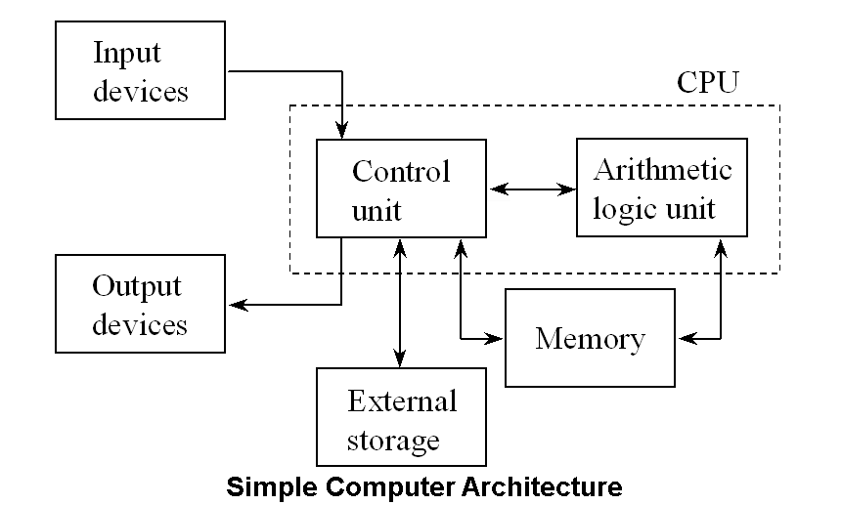
Simple Computer Architecture

Slide 4
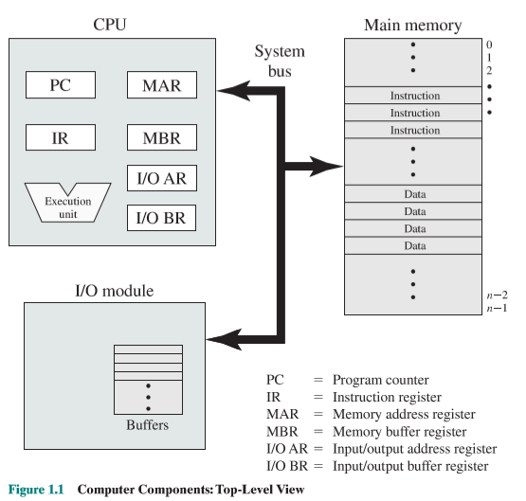
Simple Computer Architecture

Slide 5
Computer System Components
1. Hardware – provides basic computing resources (CPU, memory, I/O devices).
2. Operating system – controls and coordinates the use of the hardware among the various application programs for the various users.
3. Applications programs – define the ways in which the system resources are used to solve the computing problems of the users (compilers, database systems, video games, business programs).
4. Users (people, machines, other computers).

Slide 6
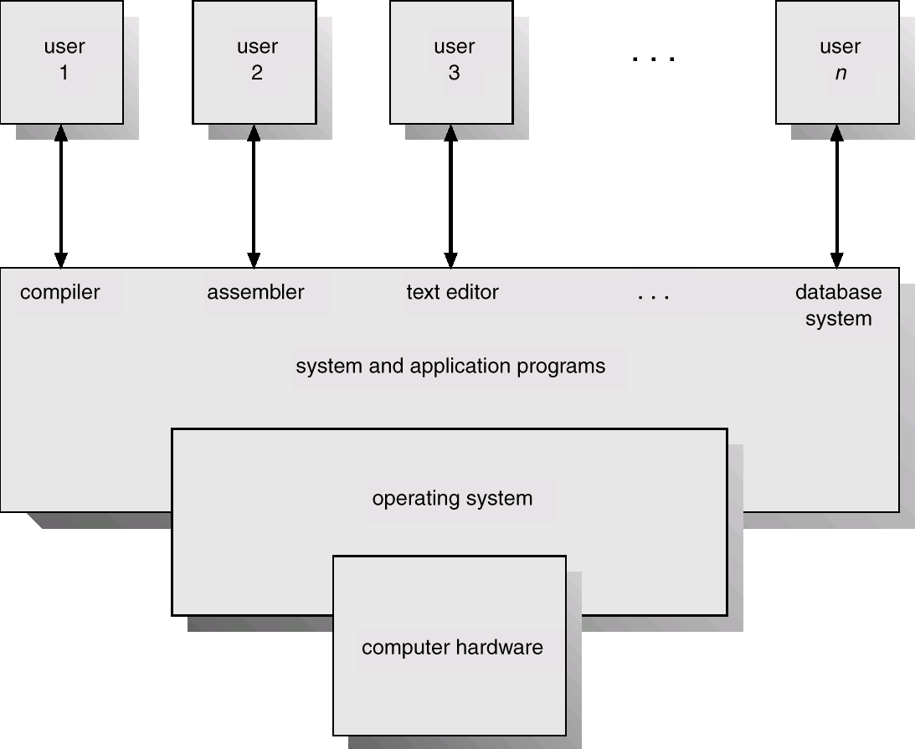
Computer System Components

Slide 7
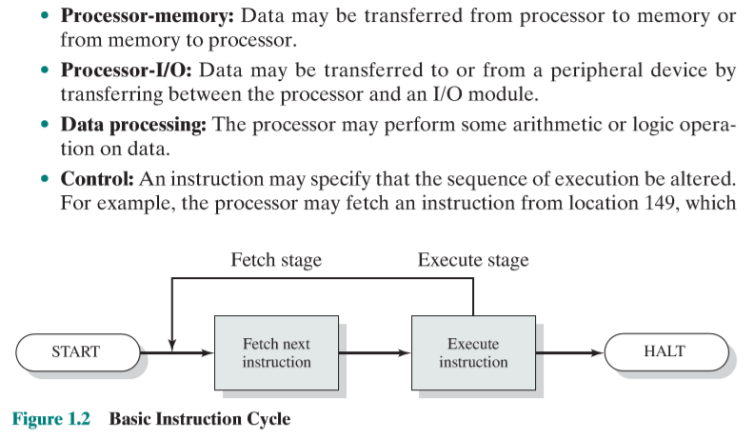
Instruction Execution

Slide 8

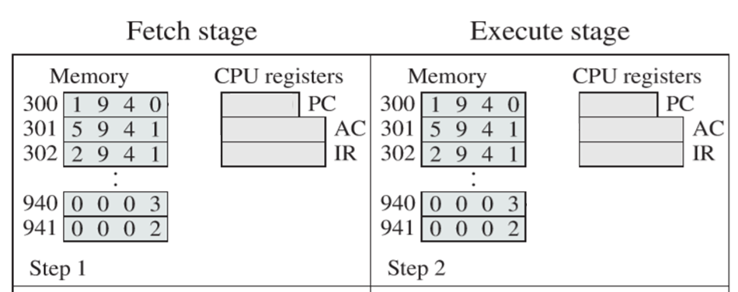
Instruction Execution

Slide 9
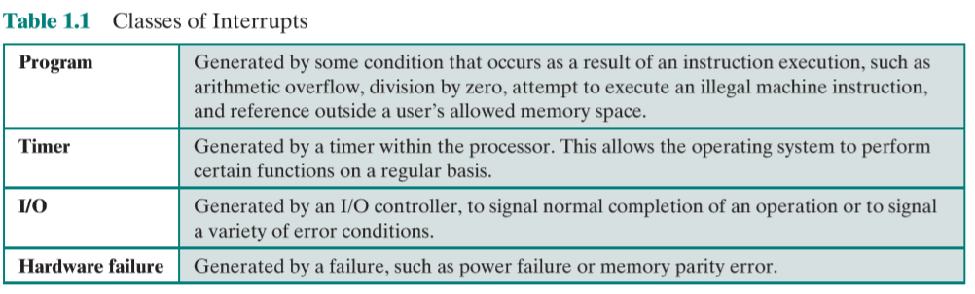
Interrupts
Signal generated by IO Devices to get the attention of CPU
Move ah, 01h
Int 21h
etc

Slide 10
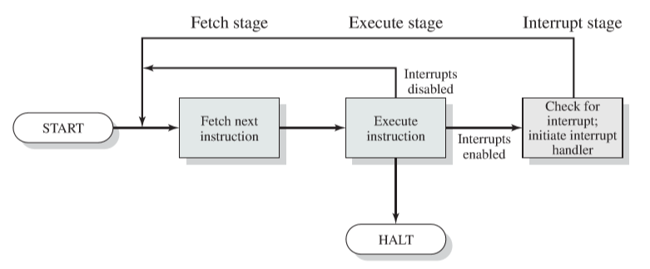
Instruction Cycle + Interrupts

Slide 11
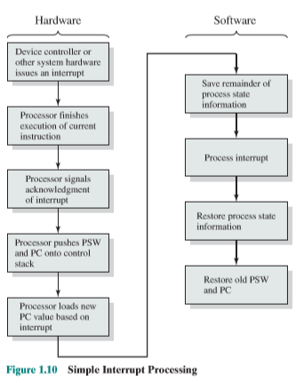
Interrupts Processing

Slide 12
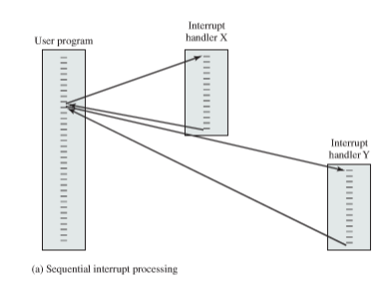
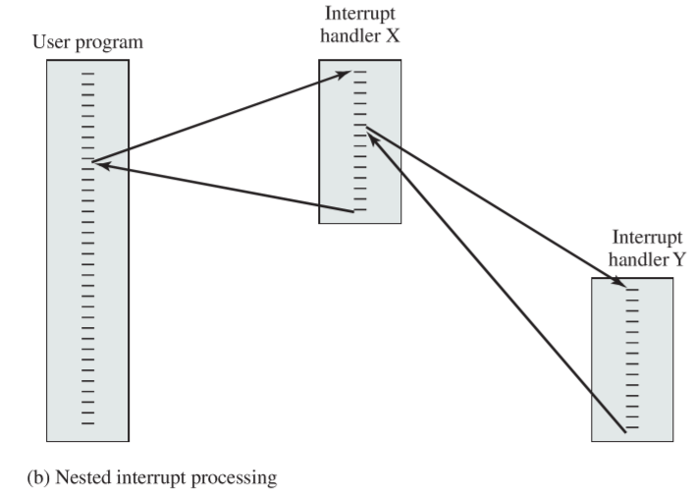
Multiple Interrupts

Slide 13
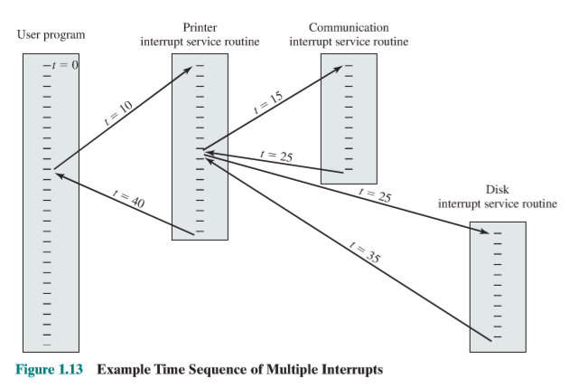
Multiple Interrupts - Priority

Slide 14
Common Functions of Interrupts
Interrupt transfers control to the interrupt service routine generally, through the interrupt vector, which contains the addresses of all the service routines.
Interrupt architecture must save the address of the interrupted instruction.
Incoming interrupts are disabled while another interrupt is being processed to prevent a lost interrupt.
A trap is a software-generated interrupt caused either by an error or a user request.
An operating system is interrupt driven.

